Slide 1
Data Science Basics in R:
Day 1

Slide 2

Introductions

Slide 3
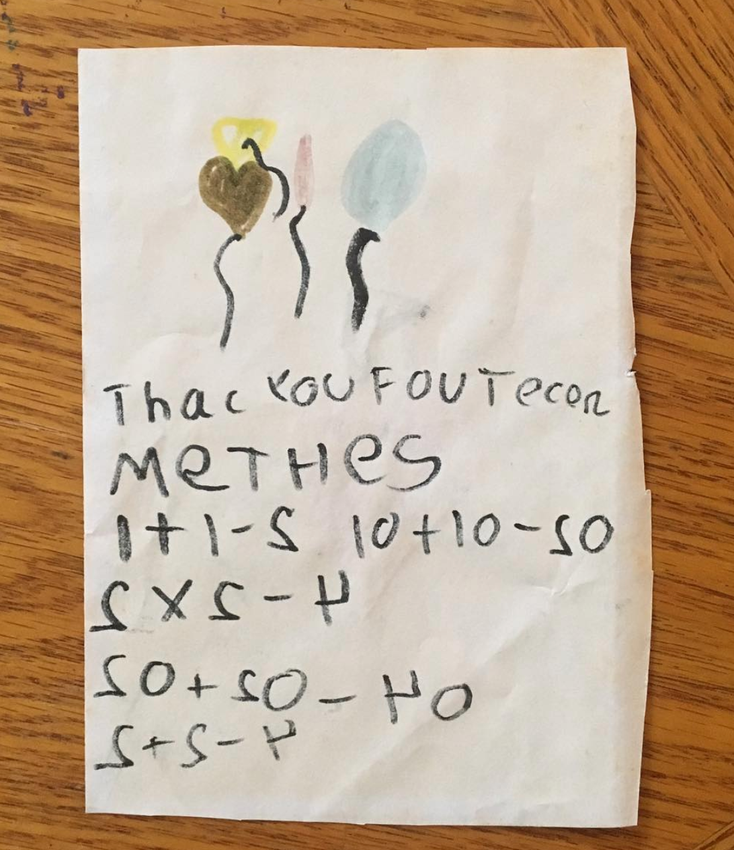

Introductions

Slide 4
Introductions
Your name
What you do for school, work, and/or fun
Why you signed up for this class

Slide 5
Housekeeping notes
Take a break whenever you need one, we will also have a few structured breaks as a larger group
Outlet locations
Trash cans
Try to come with a charged laptop

Slide 6
What to expect: learning R
Learning R is fun! And also frustrating.
You won’t be an expert by the end of these 4 days.
But over time and as you practice, it gets easier!

Slide 7
What to expect: the next 4 days
We’ll balance slides/demos with hands-on time
You decide how you learn best
listening with your computer away
laptop out and typing along…
taking notes with paper/pen
If you are constantly responding to work emails or Slack messages during our time together, you’ll probably have trouble following along (I can be guilty of this too)

Slide 8
Workshop goals
This workshop will build literacy and basic proficiency in statistical programming, with a focus on the skills needed to conduct data analyses in professional healthcare and public health workspaces.
We will cover the basics of data management, data cleaning, data visualization, and basic statistical calculations in R, and version control in github. Participants will leave with a small portfolio of relevant data visualizations and analyses completed using a real‐world public health dataset.

Slide 9
Workshop goals
This workshop will build literacy and basic proficiency in statistical programming, with a focus on the skills needed to conduct data analyses in professional healthcare and public health workspaces.
We will cover the basics of data management, data cleaning, data visualization, and basic statistical calculations in R, and version control in github. Participants will leave with a small portfolio of relevant data visualizations and analyses completed using a real‐world public health dataset.
Learning to program (in R) can be fun, and doesn’t have to be overwhelming or intimidating

Slide 10
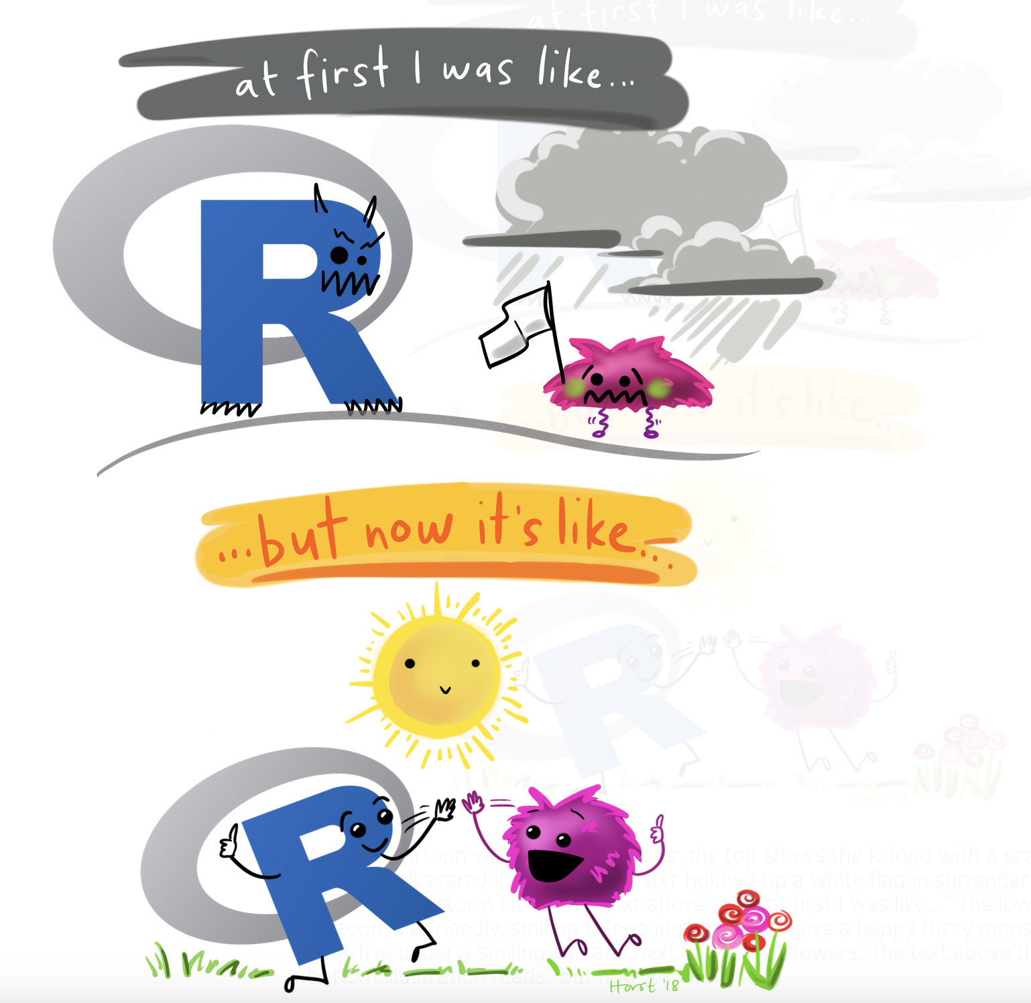
Artwork by Allison Horst
https://allisonhorst.com/everything-else

Slide 11
Goals for today
Understand what statistical programming is
Get acquainted with Rstudio
Write your very first R code (at least, of this workshop)
vectors
functions
accessing documentation

Slide 12
What is statistical programming, and why should I care?

Slide 13
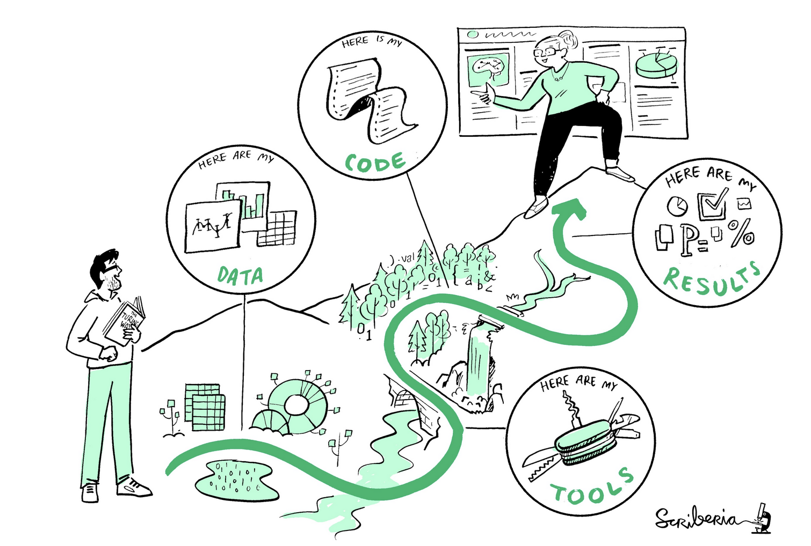
What is statistical programming?
Statistical programming is using code to clean, analyze, visualize, and interpret data
This illustration is created by Scriberia with The Turing Way community. Used under a CC-BY 4.0 licence. DOI: 10.5281/zenodo.3332807

Slide 14

What is R?
R is a programming language for statistical computing
Created by Ross Ihaka and Robert Gentleman in 1996
R is open-source and free
Many people use R in different ways and for different purposes, but it’s defined specifically for data analysis and visualization (unlike other open-source languages like python)
Notes:
See original Ihaka and Gentleman publication https://www.jstor.org/stable/1390807

Slide 15

What is R Studio?
R Studio is, put simply, a place to write and run R code
It’s an IDE (integrated development environment) and supports both R and python
It’s also free (with enterprise upgrades)

Slide 16
Why learn R?
Learning R helps you understand your data and understand how analysis works, whether you’re a researcher, a data scientist, or someone who collaborates with folks who do analysis
Coding helps you think rigorously about your questions
It’s free (vs. other expensive tools like SAS or SPSS)
Sharable, reproducible code and research
Lots of academics/companies/agencies use it
It’s fun (honestly)

Slide 17
Getting acquainted with RStudio

Slide 18
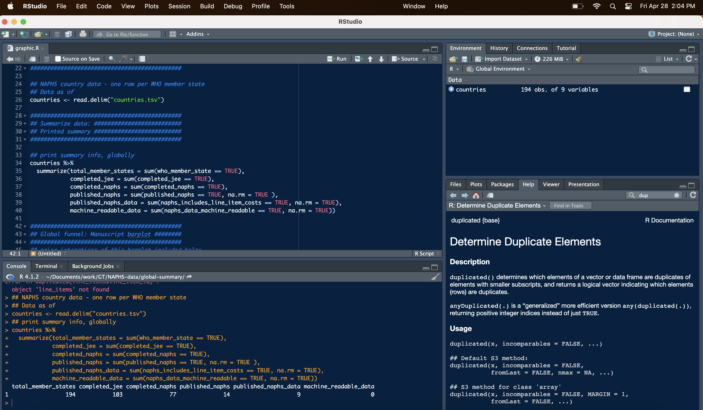
R Studio Console
Notes:
See more information here: https://intro2r.com/rstudio_orient.html#cons

Slide 19
R Studio Console
Write R scripts to re-use (.R files)
Notes:
See more information here: https://intro2r.com/rstudio_orient.html#cons

Slide 20
R Studio Console
This button runs code
(easier to see on your laptop)
Run one-off code here, or see the results of code you ran from above
Notes:
See more information here: https://intro2r.com/rstudio_orient.html#cons

Slide 21
R Studio Console
Stuff you have in memory
(e.g., datasets)
Notes:
See more information here: https://intro2r.com/rstudio_orient.html#cons

Slide 22
R Studio Console
Documentation and figures
Notes:
See more information here: https://intro2r.com/rstudio_orient.html#cons

Slide 23
R Basics

Slide 24
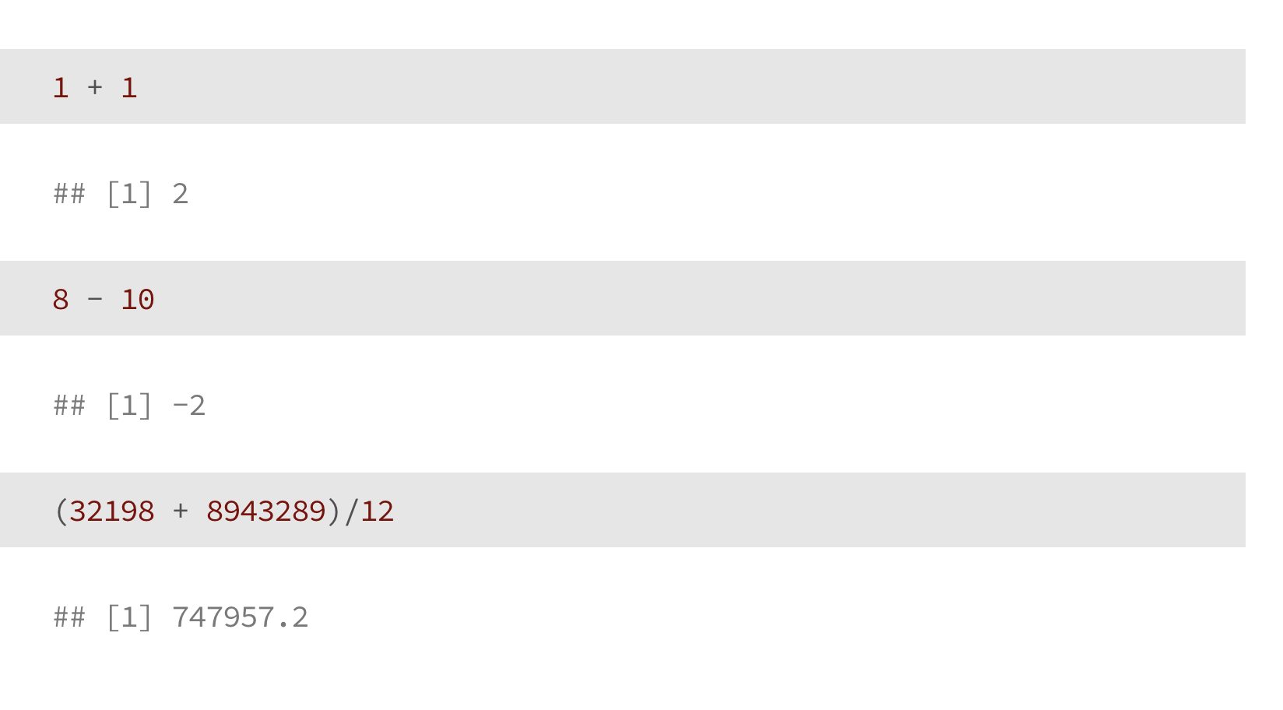
Using R as a Calculator

Slide 25
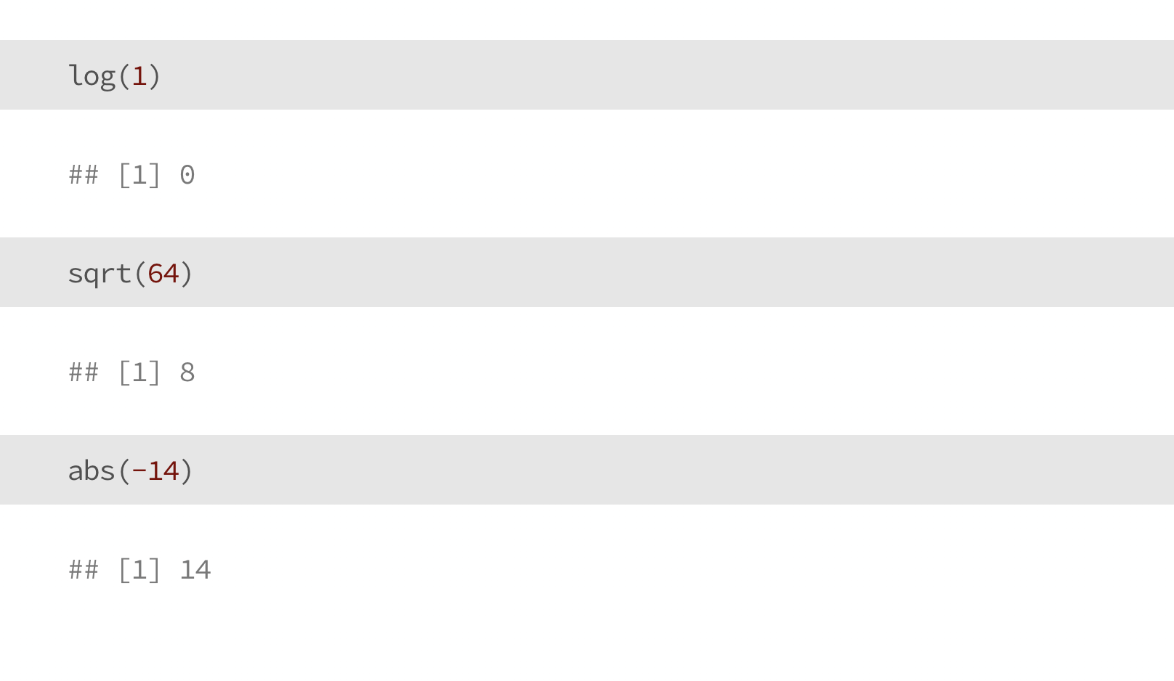
Using R as a Calculator

Slide 26
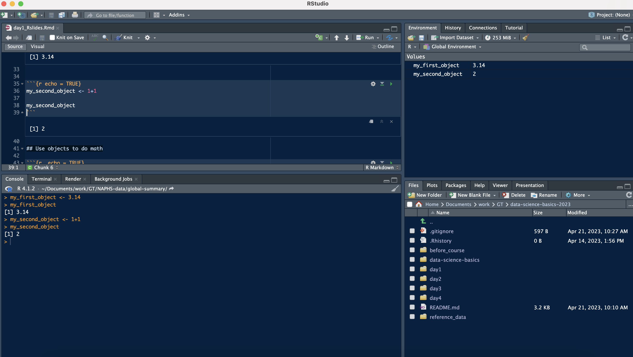
Objects
Our new objects are shown up here

Slide 27
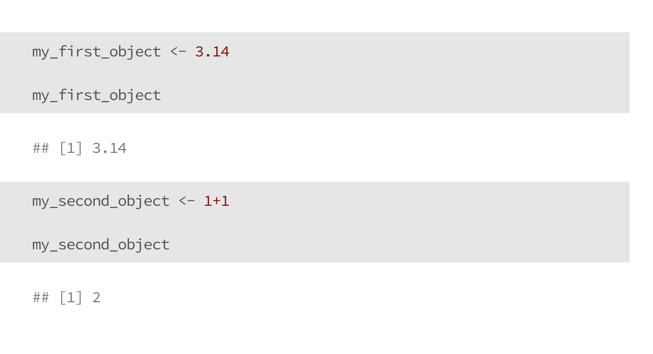
Objects

Slide 28
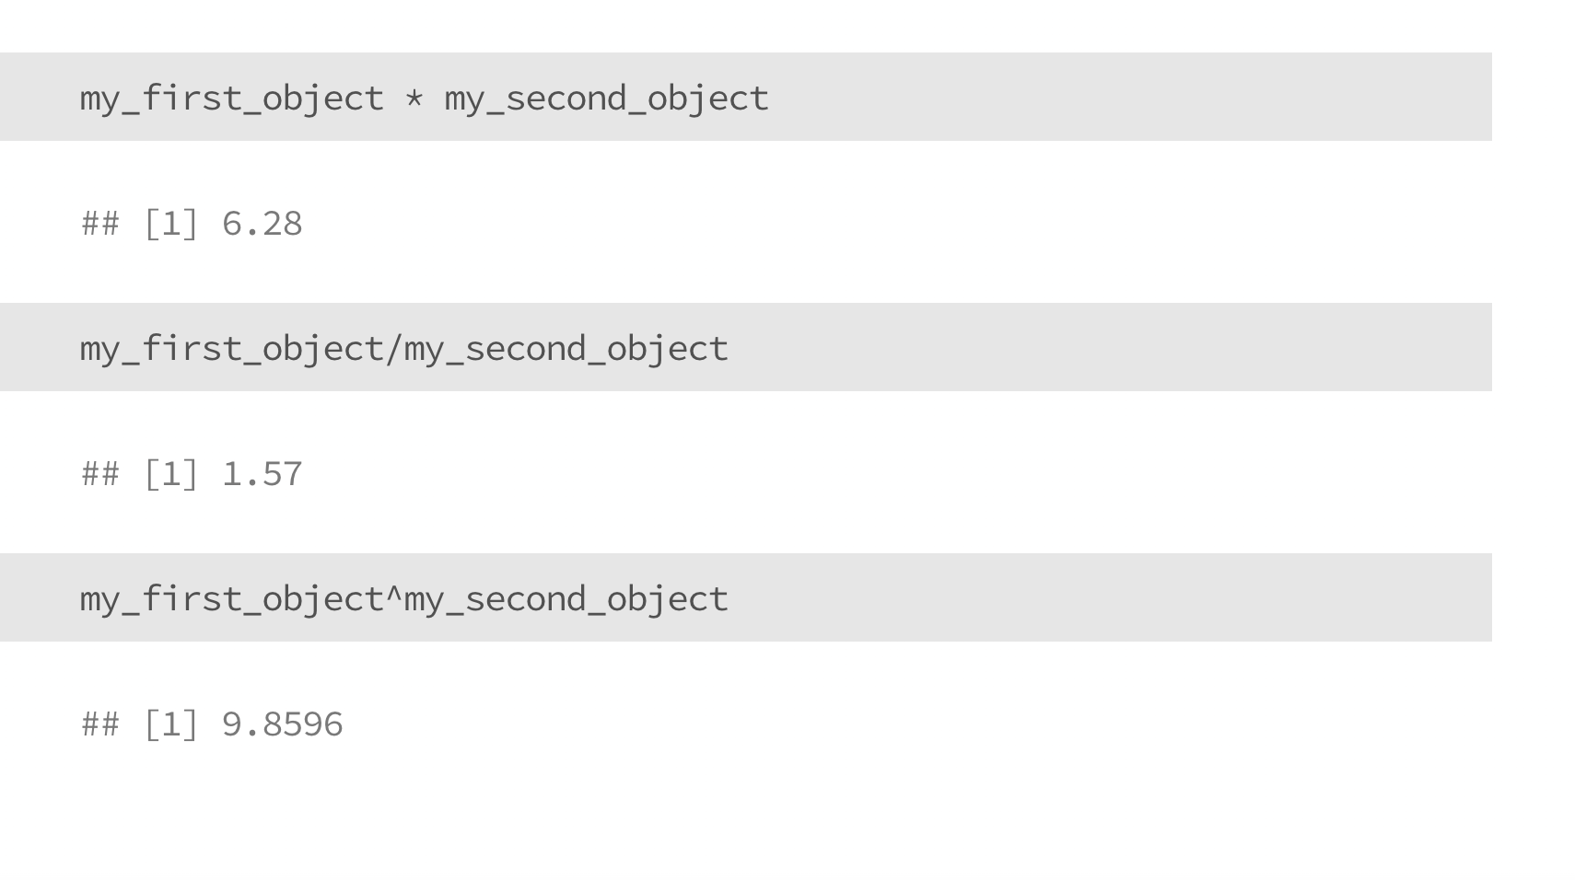
Use (numeric) objects to do Math

Slide 29
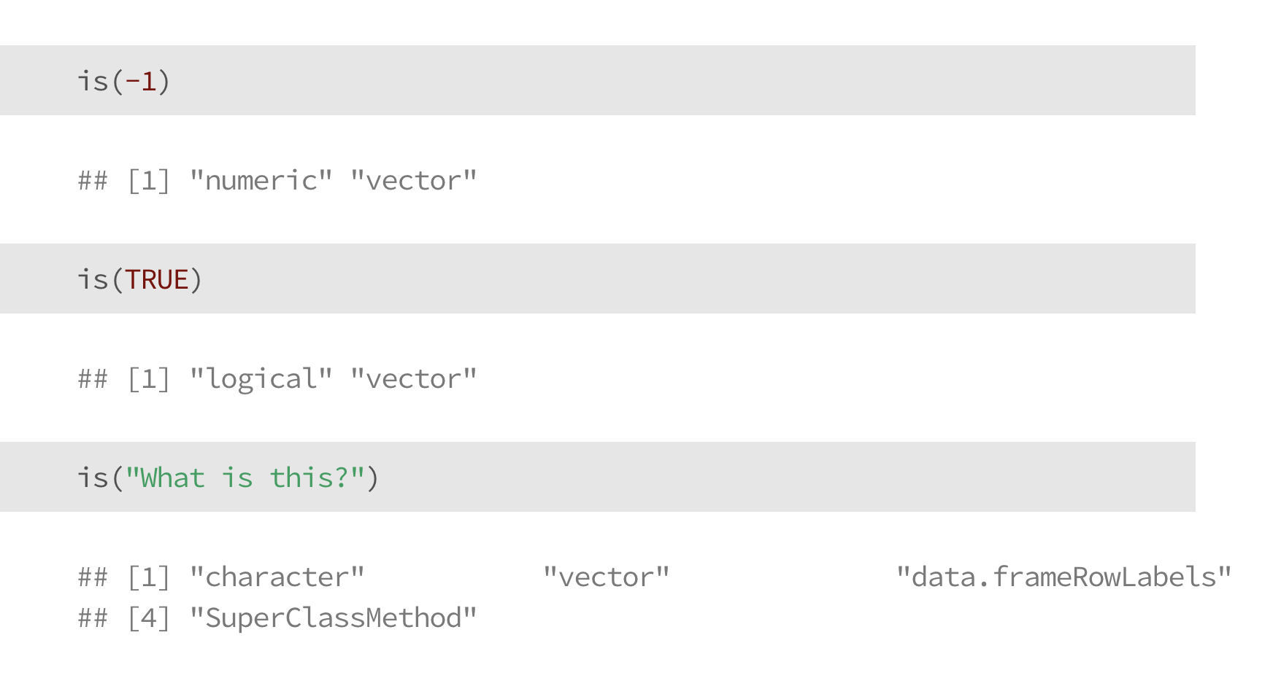
Data types in R
numeric: a number (e.g., -1, 0, 893243.343)
logical: TRUE or FALSE
character: letters and words (tricky – or a number stored as a string)
is() will help us learn the data type of a given object

Slide 30
Numeric Data

Slide 31
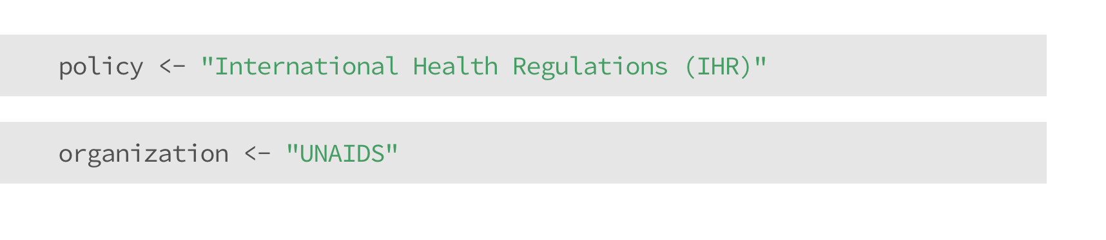
Character Data

Slide 32
Logical Data

Slide 33
Check your understanding

Slide 34
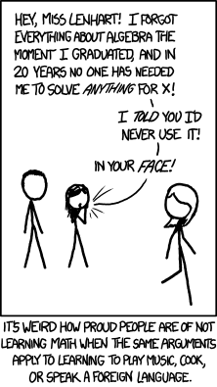
Now you try!
Pick your favorite number, and save it as an object
Pick another number, and save it as another object
Do one basic calculation (e.g., addition) with your objects
(You may run into issues, that’s okay! We’ll talk them through.)
Figure credit: XKCD

Slide 35
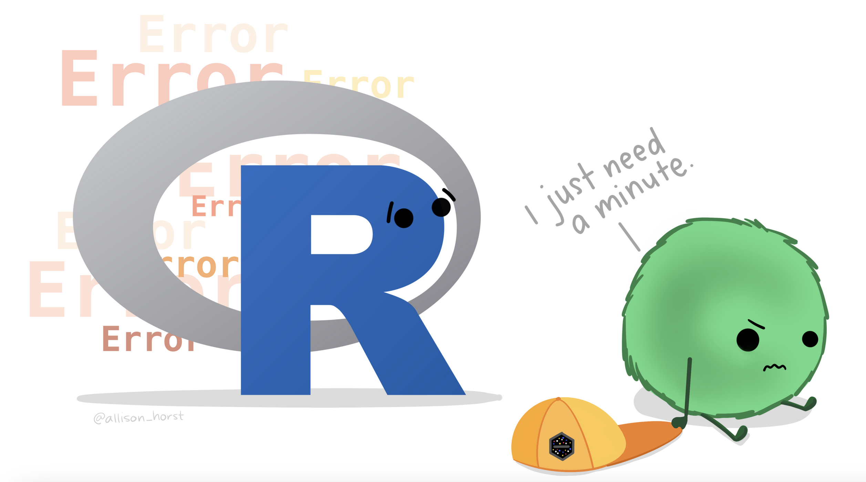
Artwork by Allison Horst
https://allisonhorst.com/everything-else

Slide 36
Rules for naming objects
Hard rules in R: a variable name can’t start with a number or a dot (.)
General rules of thumb: try to be consistent with formatting and naming
snake_case
camelCase
whatever.this.is
Chose a name you’ll understand when you open your code the next day, or when someone else reviews it
Notes:
See more information here: https://intro2r.com/objects-in-r.html#naming-objects

Slide 37
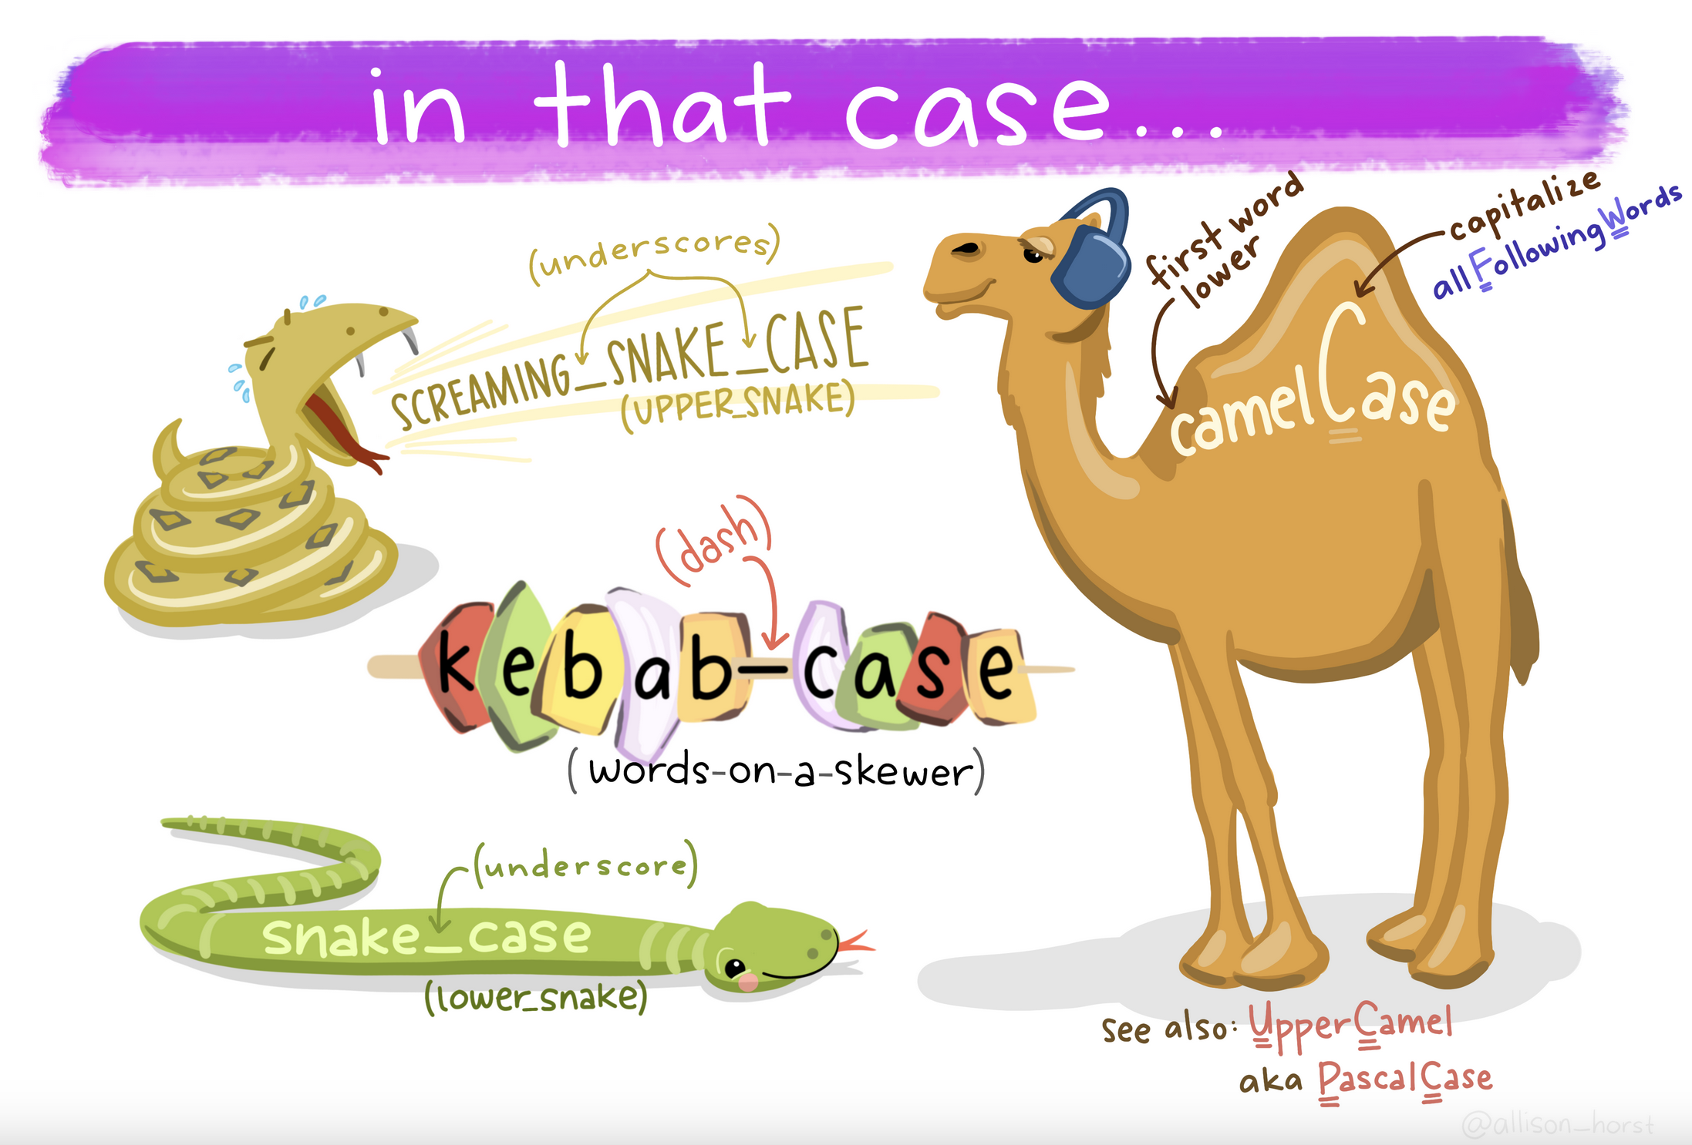
Artwork by Allison Horst
https://allisonhorst.com/everything-else

Slide 38
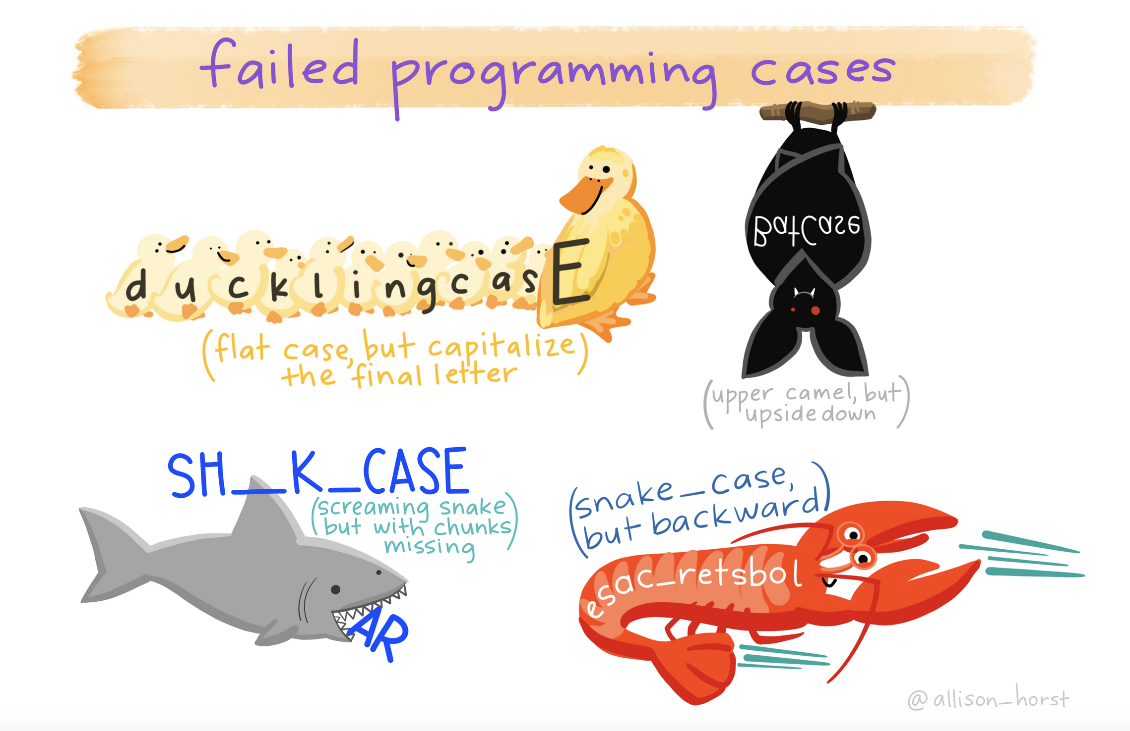
Artwork by Allison Horst
https://allisonhorst.com/everything-else

Slide 39
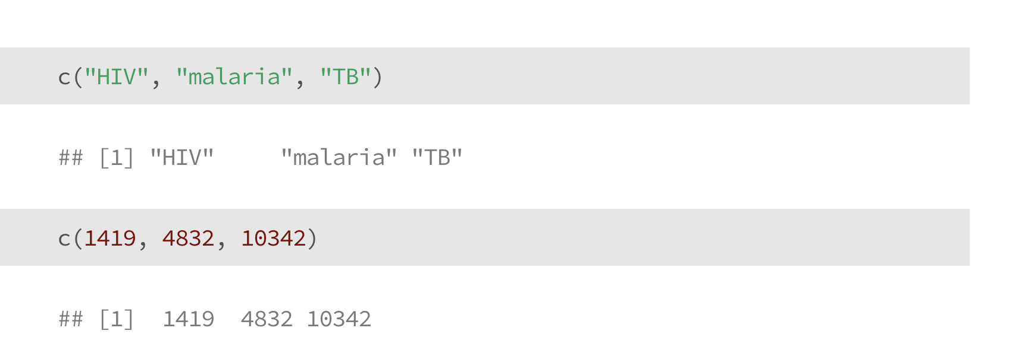
Vectors
Notes:
See more information here: https://intro2r.com/using-functions-in-r.html

Slide 40
Vectors
The c() stands for “concatenate”
Notes:
See more information here: https://intro2r.com/using-functions-in-r.html

Slide 41
Vectors
Vectors can contain strings
Or numbers
Notes:
See more information here: https://intro2r.com/using-functions-in-r.html

Slide 42
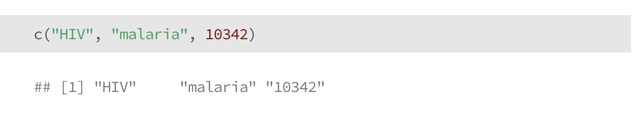
Vectors
Vectors can contain strings
Or numbers
… but not both
What happened here?
Notes:
See more information here: https://intro2r.com/using-functions-in-r.html

Slide 43
Functions
Functions are instructions to perform a task
They are algorithms, or consistent set of rules
R has built-in functions for many basic things
Functions generally look like this: function(object)
We can also “add on” extra functions by loading new libraries (we’ll get to this later), or we can write our own functions to do whatever we want

Slide 44
Functions
Most functions in R are vectorized
This means they act on all items in a vector
Why does this matter?
If you misunderstand it, your math will be wrong
It’s useful for basic calculations and analysis:
divide all numbers by 100 to calculate a %
multiply per-capita rates by total population

Slide 45
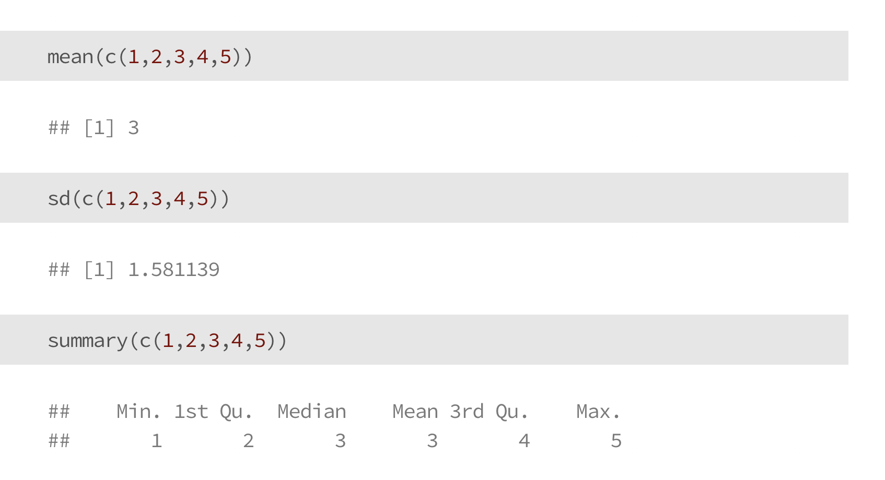
Functions

Slide 46
Functions

Slide 47
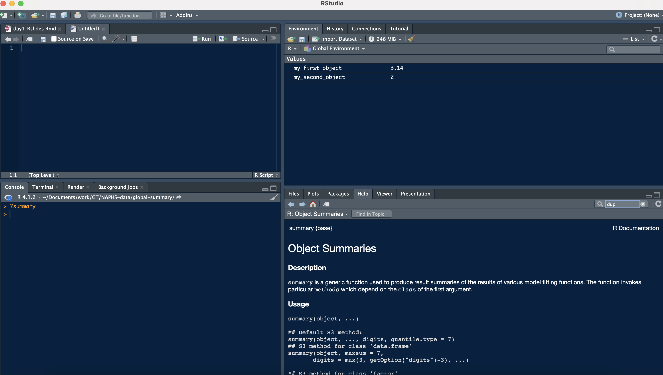
Learn more about functions
?summary or help(summary)
This is documentation about the summary() function
Type ? and then the function name:
?summary
?sd
?mean
etc…

Slide 48
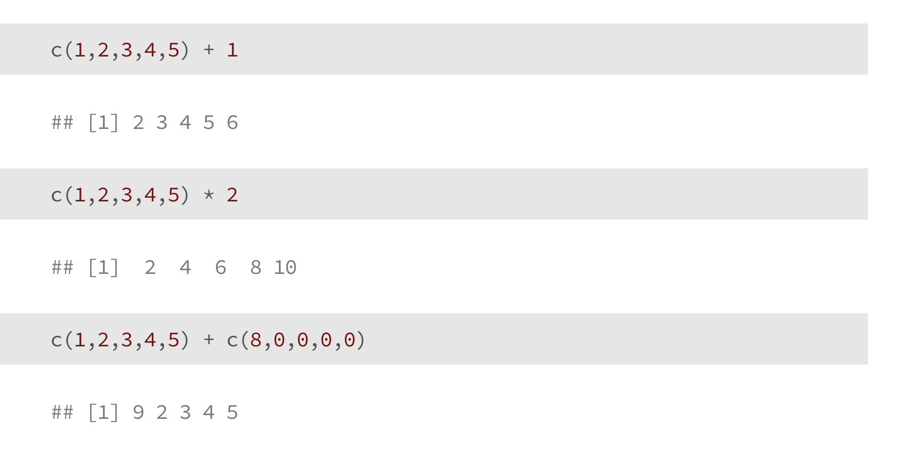
Vectorized Calculations

Slide 49
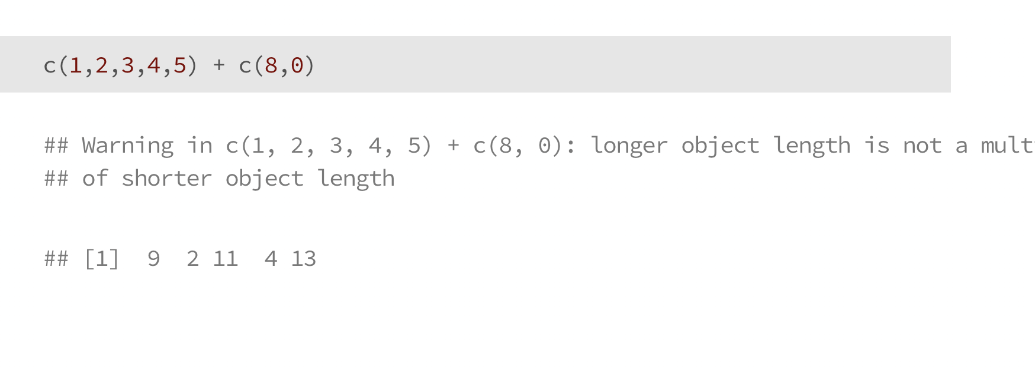
Vectorized Calculations

Slide 50
Syntax
R is case sensitive (‘A’ is different than ‘a’)
Commands are separated by a new line
# marks comments, this code won’t run

Slide 51
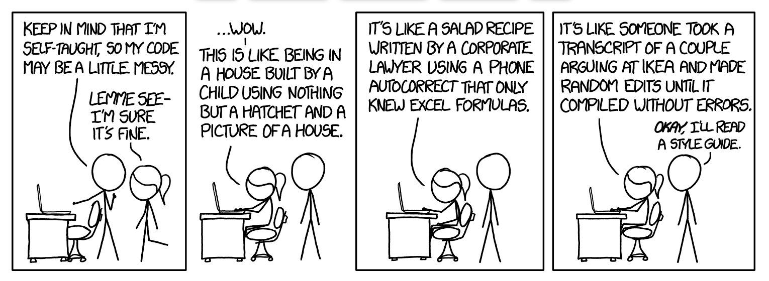
Documenting your code
As we start writing code, it’s helpful to leave “notes” for yourself and others reminding yourself what you did
Comments can also help break code into sections

Slide 52
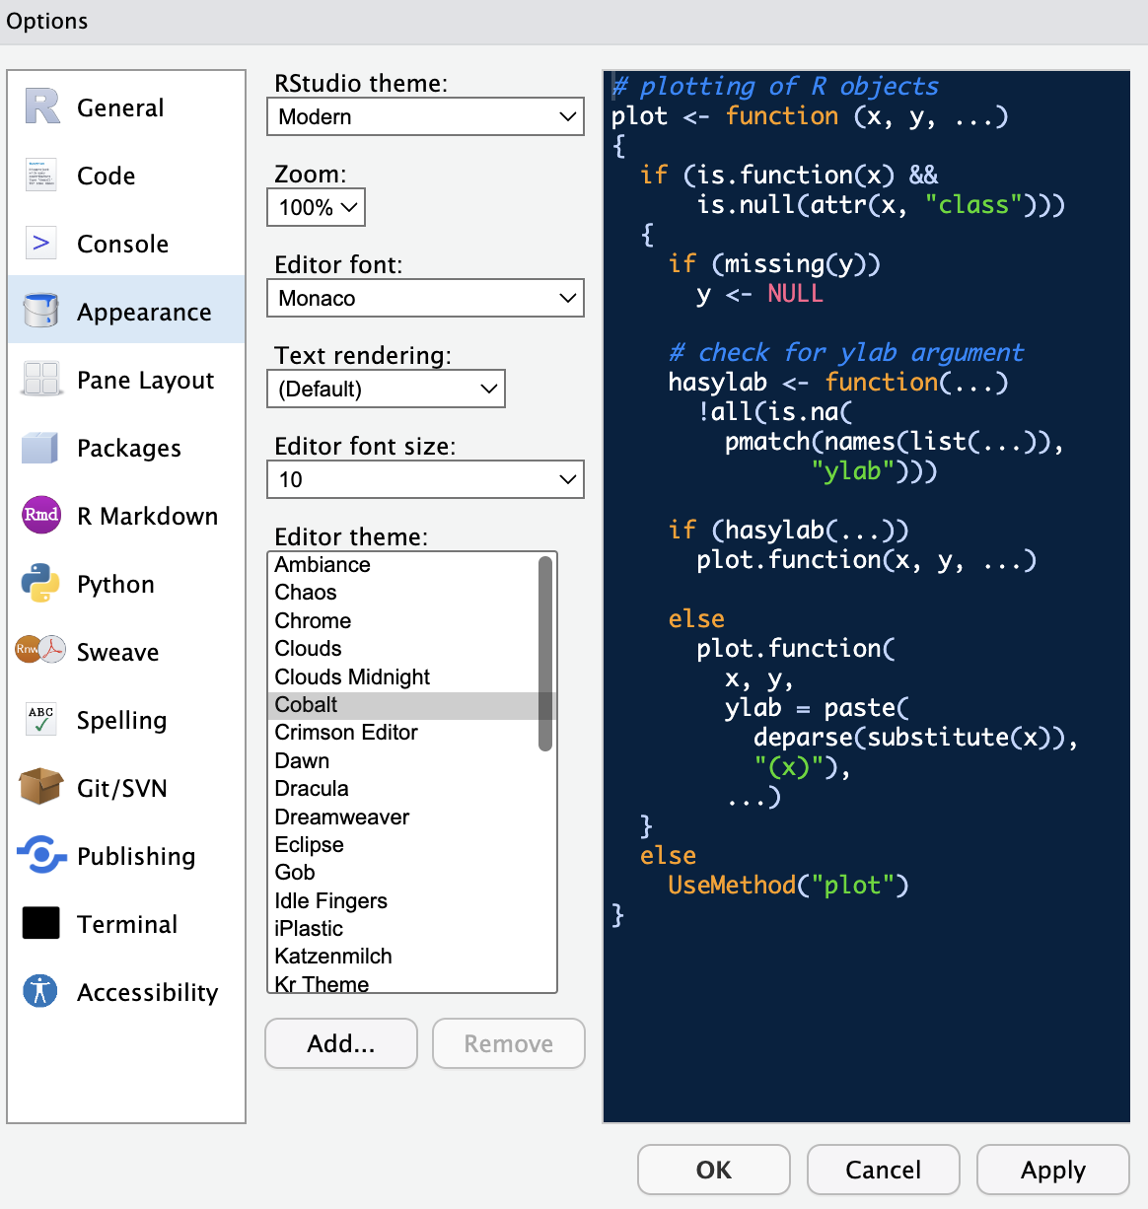
Changing R Studio Appearance
Navigate from the top bar
-> Tools
-> Global options
-> Appearance
(then click “apply”)

Slide 53
Thank you!
See you tomorrow.
Please come with a fully charged laptop.
Lecture and course material adapted from Intro to R materials created by Alex Douglas, available online here, with corresponding free online textbook.

